Slide 1
S/B Ex.8, P.127
Describe the pictures.

Slide 2

If the climber had listened to the weather forecast, he would not have gone climbing.

Slide 3

If the man had left his house earlier, he would not had missed his bus.

Slide 4

If the player had practiced more, he would not had lost the match.

Slide 5
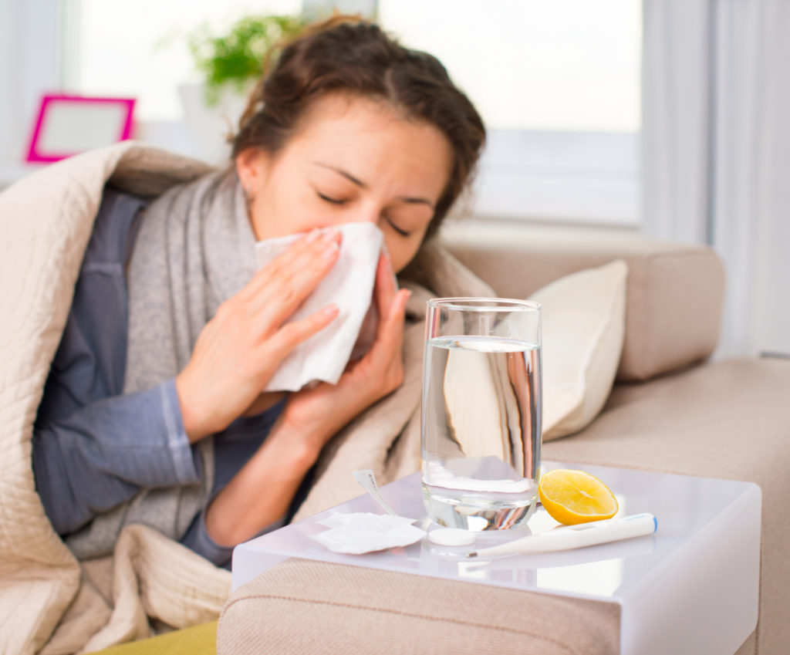
Put on a warm sweater to be ill

Slide 6
If you had put on a warm sweater, you would not have been ill.

Slide 7

Get a scholarship go to London to master your English

Slide 8
If you had got a scholarship, you would have gone to London to master your English.

Slide 9
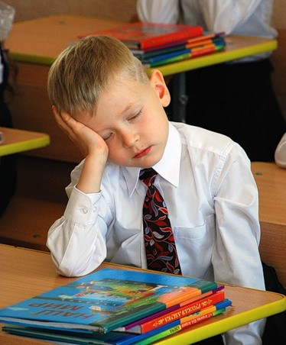
go to bed earlier to sleep at the lesson

Slide 10
If you had gone to the bed earlier, you would not have slept at the lesson.

Slide 11
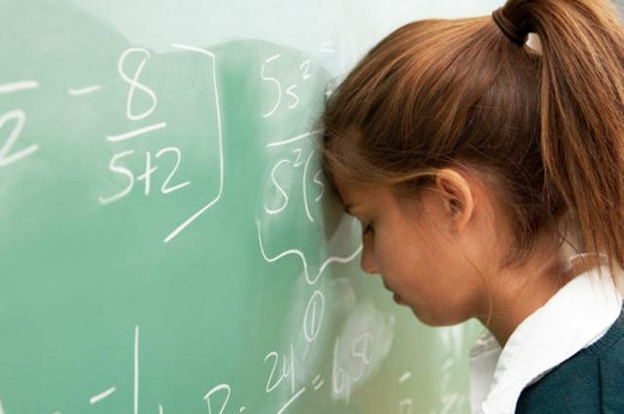
learn the rule solve the problem

Slide 12
You would have solve the problem if you had learnt the rule.

